Slide 1
Signal Switch
1) Output needs to switch on if input has remained steady over a specified period of time.
2) Given 1), output must remain steadily switched on, till input remains steady beyond a specified period of time.
3) Write an array of integers as signal data to a text file
4) Use this text file to read signal data for completing 1) and 2)

Slide 2
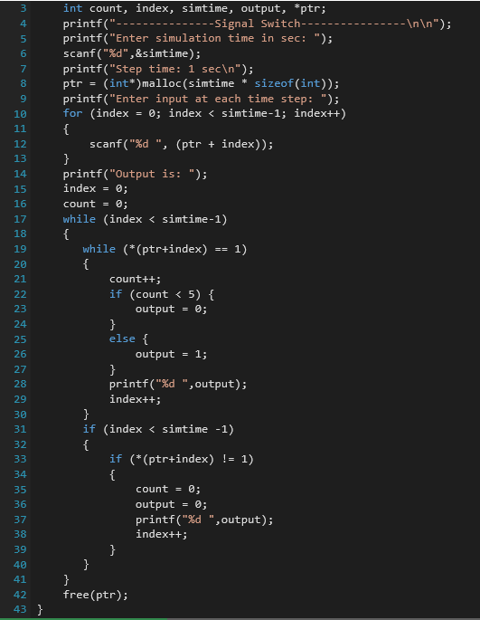
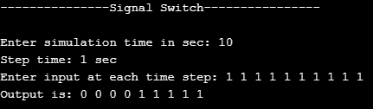
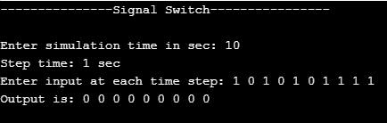
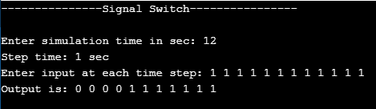
Output cases:
Out put is expected to have a value 1 if input maintains a steady value of 1 till 5 seconds.
Output is expected to remain 1 till the time input maintains 1 beyond 5 seconds
Minimum limit of 5 sec
Main Function

Slide 3
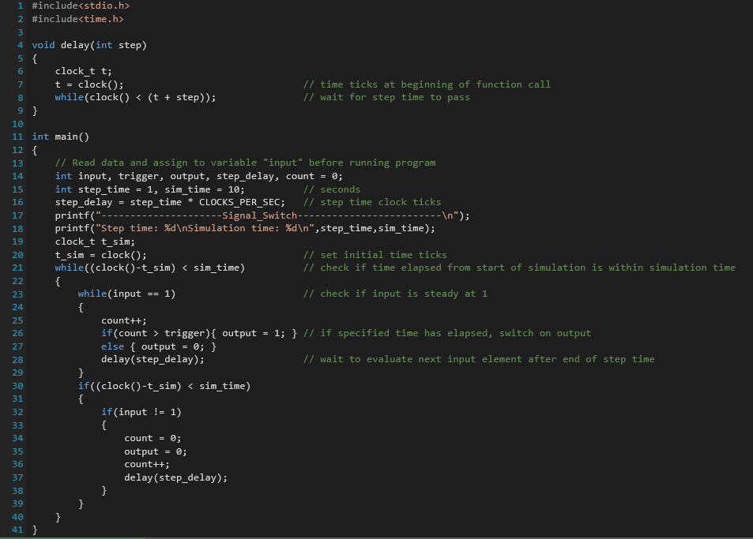
External input signal
Input can be any signal being read from a file
Input to be synchronized with respect to processor clock time
The step time of input signal must correspond to time elapsed in the processor
Clocks per second of processor can be used to delay processing of next input element until step time has passed. (empty while loop)
Assumptions: simulation and step time are known

Slide 4
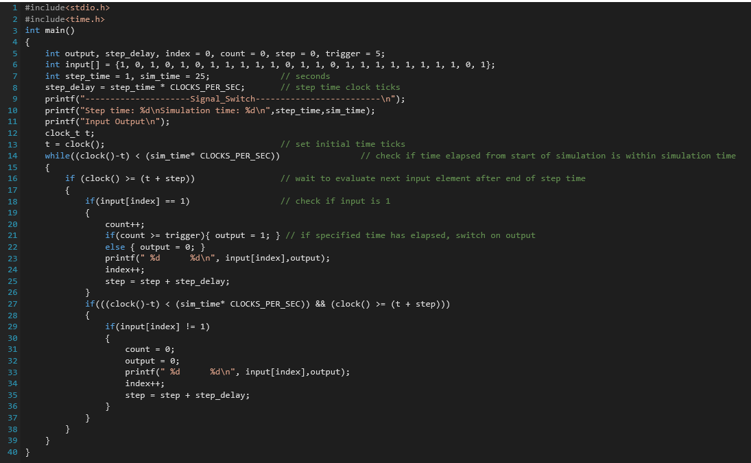
Modification to code in Slide 3
1) Same as slide 3 except, instead of following read->check->delay approach, it can be read->check->read next sample and increment count only if step time has passed.
2) This will not hold up controller in a delay function with empty while loop, unlike in code on slide 3, which means controller is not kept busy

Slide 5
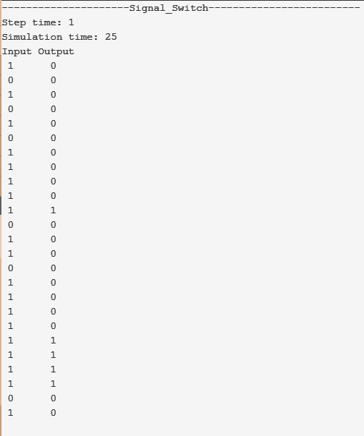
Result

Slide 6
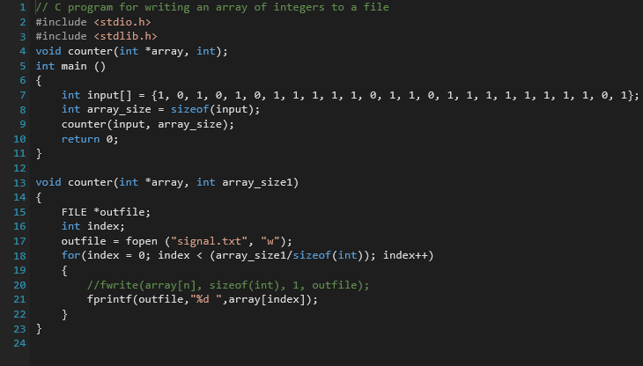
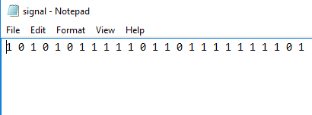
Write input to a file
Program creates a text file, “signal.txt” into which an array of integers is written.
This text file serves as input data file to a “read-data-and-apply-logic” code in slide 8

Slide 7
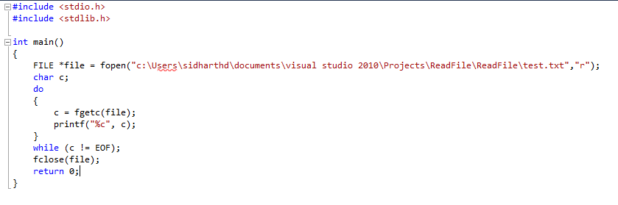
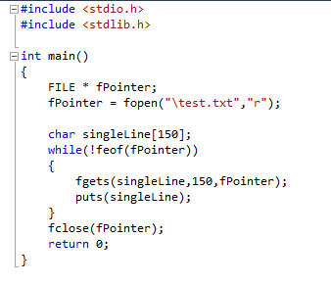
Read input signal example

Slide 8
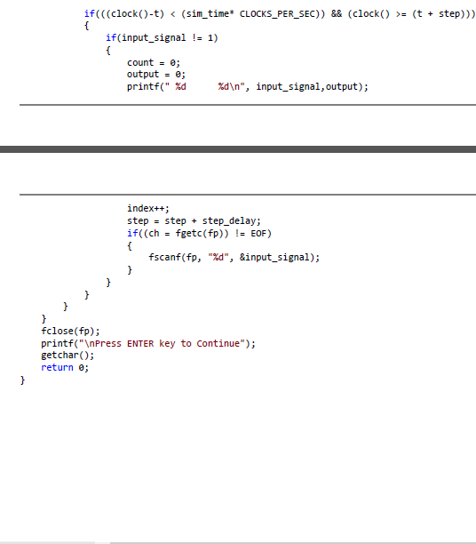
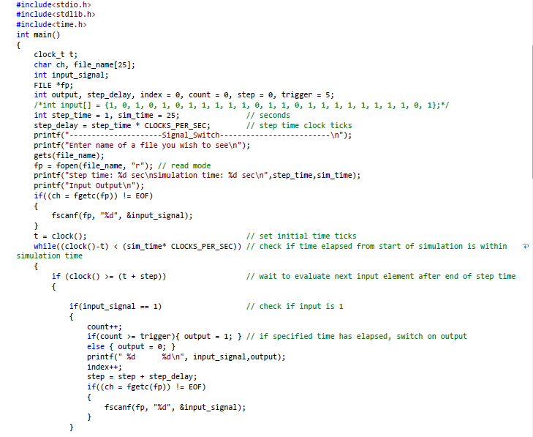
Read input from generated file in slide 6
read next data element if not end of file

Slide 9
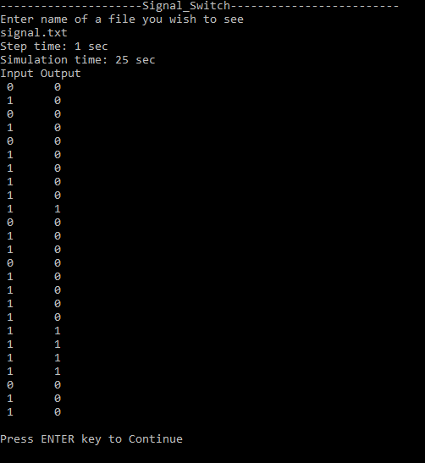
Result
Input is read from signal.txt and output is generated which is same as in slide 6

